Slide 1
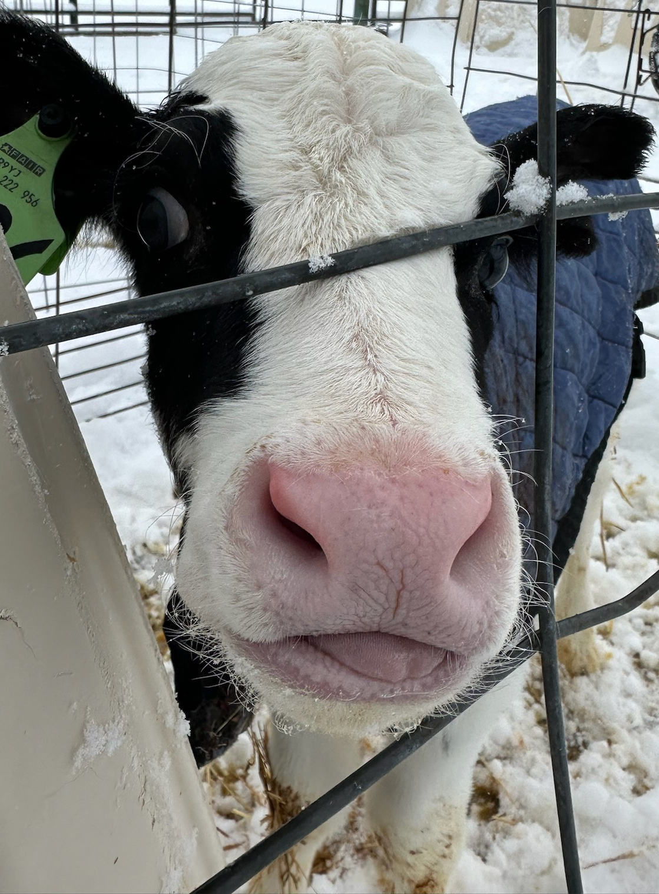
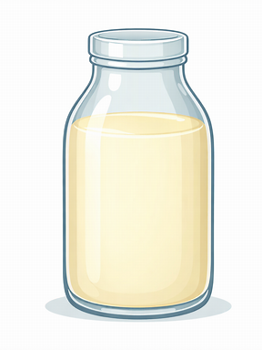
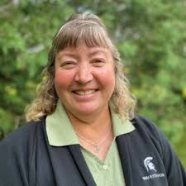
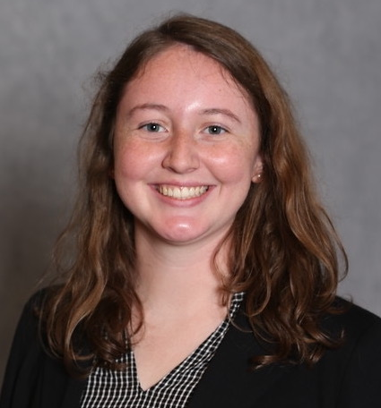
CALF PHYSIOLOGY: why is the timing of colostrum important?
4-H Dairy Spin Club and Quiz Bowl Review
Debra Barrett
(517) 355-3855
smithde6@msu.edu
Paiton McDonald
(517) 355-3855
mcdon599@msu.edu

Slide 2
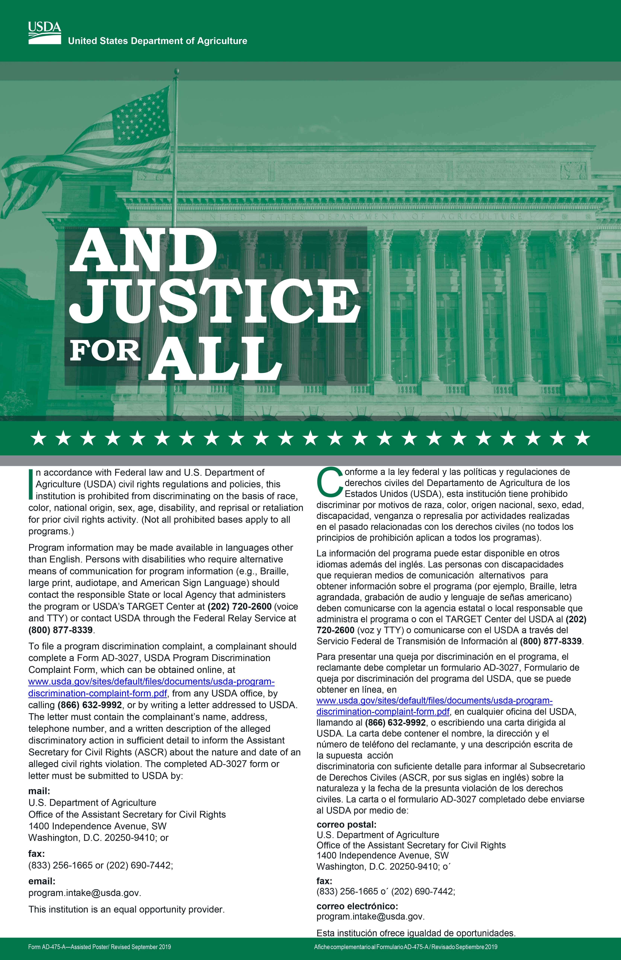
Michigan State University Extension programs and materials are open to all without regard to race, color, national origin, sex, gender, gender identity, religion, age, height, weight, disability, political beliefs, sexual orientation, marital status, family status or veteran status.

Slide 3
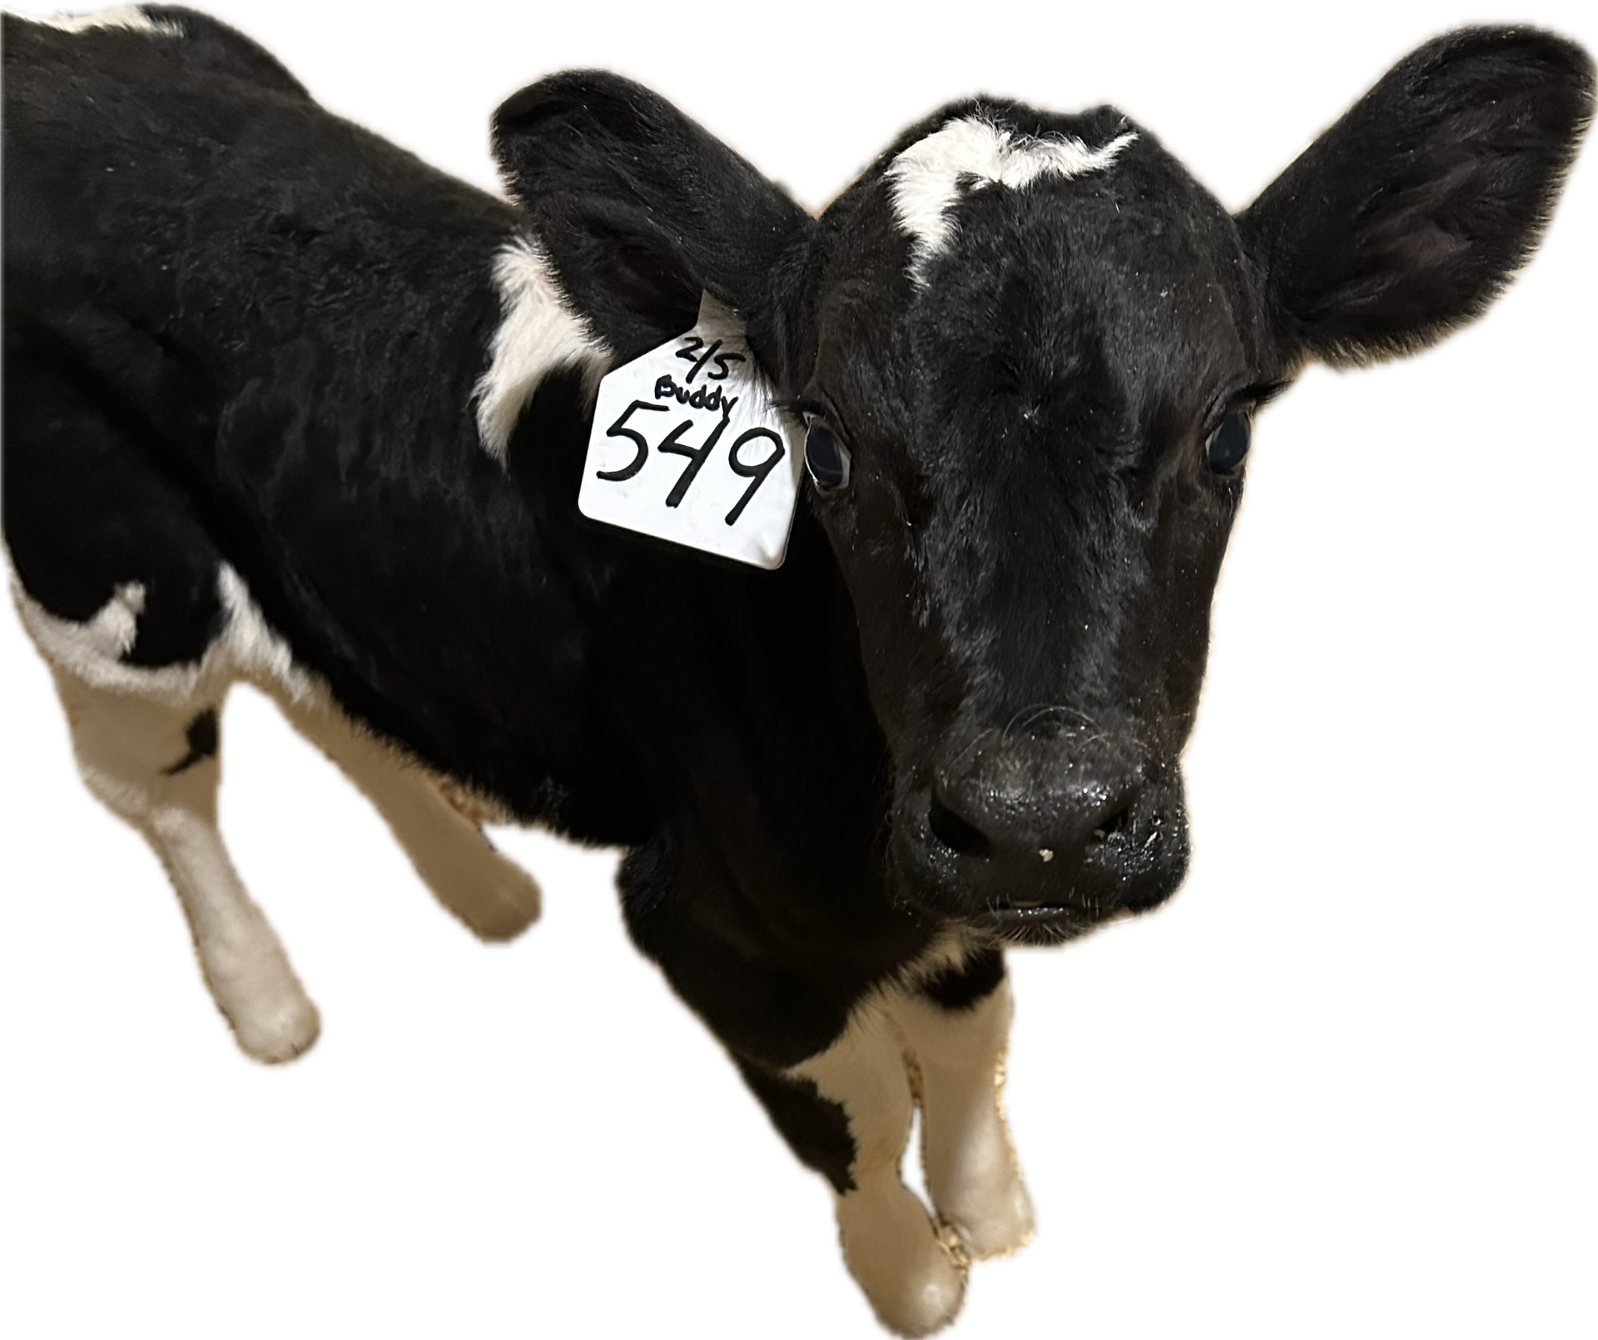
Welcome!
Today we will review the detailed makeup of the dairy calf to answer one of the more important questions on farm: when should the first colostrum meal be fed? The basics of calf health and immunity will be discussed.
This is a great lesson to expand participant’s knowledge of the dairy industry all while preparing for quiz bowl.
Notes:
Today we will review the detailed makeup of the dairy calf to answer one of the more important questions on farm: when should the first colostrum meal be fed? The basics of calf health and immunity will be discussed. This is a great lesson to expand participant’s knowledge of the dairy industry all while preparing for quiz bowl.

Slide 4
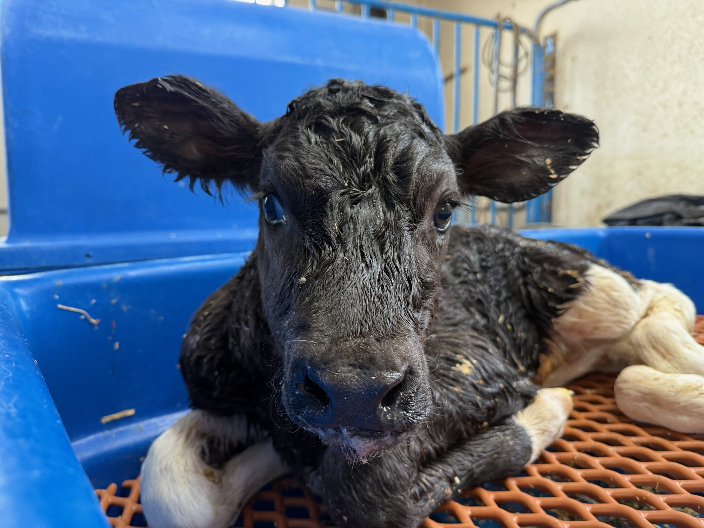
The importance of colostrum. Colostrum is one of the most important meals in a dairy calf’s life; it is a source of passive immunity.
Calves are born agammaglobulinemic, which means they are born with relatively no antibodies.
It takes a few weeks for calves to produce their own antibodies.
The calf’s mother produces a lot of antibodies in colostrum.
Chase et al., 2008
Notes:
Source: Chase et al: Chase, C.C.L. ∙ Hurley, D.J. ∙ Reber, A.J.. Neonatal immune development in the calf and its impact on vaccine response. Vet. Clin. North Am. Food Anim. Pract. 2008; 24:87-104. (https://doi.org/10.1016/j.cvfa.2007.11.001).
Calves are born relatively agammaglobulinemic which means they are born with relatively no antibodies. During pregnancy, there is something called the placenta is a temporary organ that forms to help meet the fetal requirements by transporting things like antibodies, nutrients, or oxygen. Adult cattle form placentas with special structures called cotyledons which are specialized transport spaces but do not allow for a lot of antibody transfer. This means that the calf is born without a lot of maternal derived protection and must rely on other methods to get immunity after birth. Passive immunity is a way to provide immediate immunity through another organism’s antibodies. Colostrum or the first milk produced after calving contains a lot of antibodies produced from the dam or mom cow and is a transfer method if passive immunity.

Slide 5
More About Colostrum - Colostrum is different from the milk we get in the store but is packed full of goodies.
Components, %
Godden, 2008
Notes:
Source: Godden: S. Godden. Colostrum management for dairy calves. Vet. Clin. North Am. Food Anim. Pract., 24 (2008), pp. 19-39. (https://doi.org/10.1016/j.cvfa.2007.10.005).
NOTE: There is an animation that you need to click to the next slide for before you define immunoglobulin as an antibody.
Colostrum has greater total solids than mature milk, or the milk we purchase from the store which is typically the seventh milking after calving and beyond. This means that when all the water is removed, there are more solid molecules leftover in colostrum than the milk we drink. Colostrum solids mainly contain the proteins and fat.

Slide 6
More About Colostrum - Colostrum is different from the milk we get in the store but is packed full of goodies.
Components, %
Antibodies
(Ab)
Godden, 2008
Notes:
Source: Godden: S. Godden. Colostrum management for dairy calves. Vet. Clin. North Am. Food Anim. Pract., 24 (2008), pp. 19-39. (https://doi.org/10.1016/j.cvfa.2007.10.005).
Immunoglobulins are the scientific term for antibody which are immune proteins. Not only does colostrum provide nutrition and energy to the baby calf, of the ~23% total solids almost a quarter of it is composed of the passive immunity from mom. Please also note the drop off as the cow begins milking more.

Slide 7
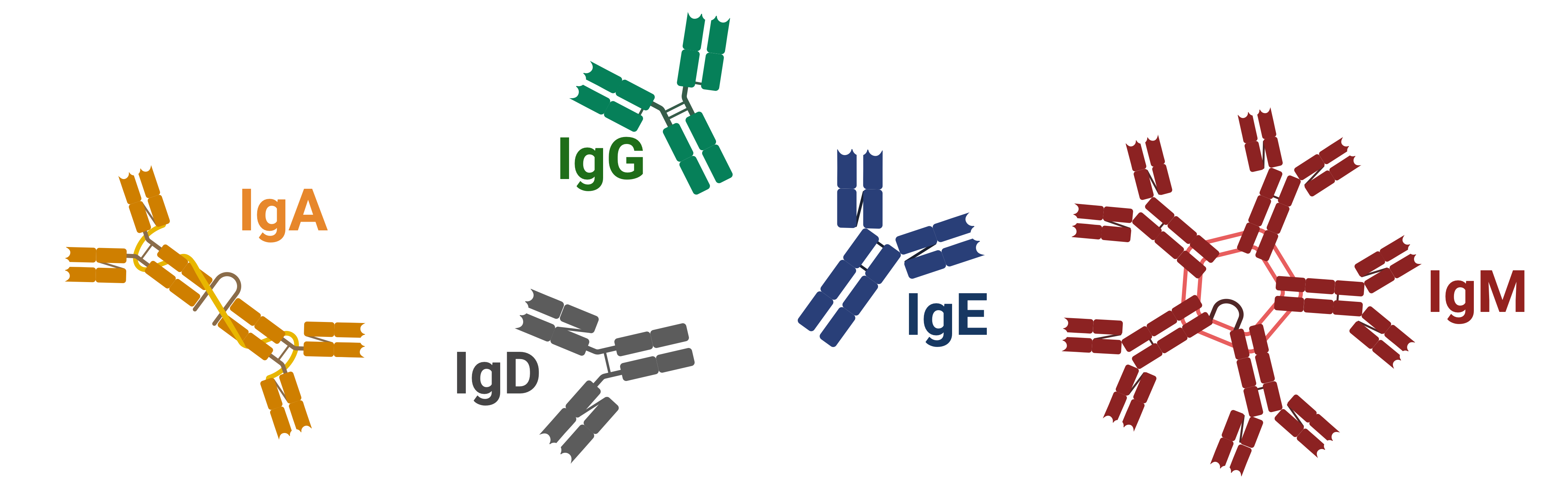
Immunoglobulins - Immunoglobulins (Ig) are important because they help your body stay safe and balanced.
IgG is more secondary
Binds bacteria, viruses and toxins
Activates complement
Protects mucosal surfaces
Maintains microbial homeostasis
First antibody made
Binds antigen
Activates complement
Image created with Biorender.com.
Notes:
Antibodies or immunoglobulins are important because they help the whole body through specialized mechanisms. We will look at three isotypes of Ig today. Isotypes are just another way of saying that they are types or classes of antibodies – each are designated by a letter corresponding to part of their protein structure (D, M, A, E, G). IgG is the most abundant in colostrum followed by IgM and IgA. IgG concentration is typically what we estimate in colostrum before feeding and in the calf serum to determine if the transfer of passive immunity was successful. IgG is typically found circulating throughout the body even though it is often typically the second class produced after a challenge, IgM is first. Both of these isotypes bind antigens (foreign entities) like bacteria or viruses that have entered the body. Then antibodies can help activate a process called the complement cascade which has several routes of pathogen clearance. IgA is often found at mucosal surfaces like the gut or along the respiratory tract because it helps micro-organisms maintain a healthy balance of good and bad microbes/ the tops of the lungs.

Slide 8
More About Colostrum - Colostrum is also a good source of molecules that help with the calf’s growth.
Minerals: bone and protein regulation
Trace minerals: antioxidants, help regulate blood and hormones
Vitamins: antioxidants, involved with immune and metabolic functions
Godden, 2008
Notes:
Source: Godden: S. Godden. Colostrum management for dairy calves. Vet. Clin. North Am. Food Anim. Pract., 24 (2008), pp. 19-39. (https://doi.org/10.1016/j.cvfa.2007.10.005).
Colostrum is the first meal a calf has so it contains a lot of factors a baby needs to start their life as a new organism. All ages require different concentrations of minerals and vitamins as do other species (like you and me!).

Slide 9
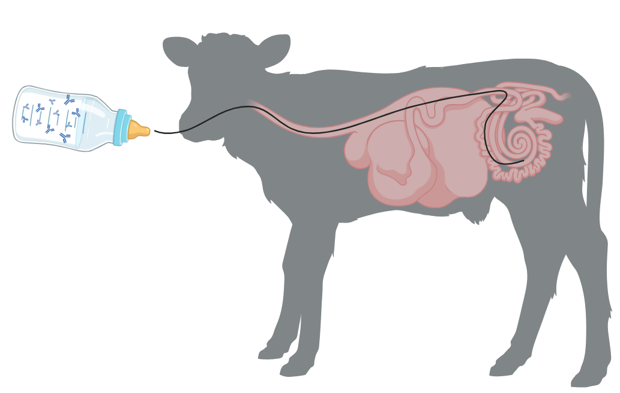
Traveling Antibodies - But how do the antibodies pass from colostrum to the calf when they drink?
Antibodies travel to the gut.
Enterocytes engulf or trap the Ab and transport it across the gut wall into the bloodstream.
Antibodies in the bloodstream help protect the whole animal.
Stott et al., 1979; Image created with Biorender.com.
Notes:
Source: Stott et al.: only available as a PDF (G.H. Stott, D.B. Marx, B.E. Menefee, G.T. Nightengale . Colostral immunoglobulin transfer in calves I. Period of absorption. J. Dairy Sci., 62 (1979), pp. 1632-1638
https://doi.org/10.3168/jds.S0022-0302(79)83472-4)
When a calf drinks their meal, the milk and all that it contains travels through the esophageal groove to reach the abomasum. Next it passes to the small intestine which has a lot of different cell types, including enterocytes. Enterocytes are just a special type of cell that line the gut. For a short amount of time, the calf’s enterocytes put the antibody in a little transport vesicle (think of it like a bubble) and takes it safely through the cell to the other side so it can pass to the blood stream. Another way to think of this process is the cells turn into a chowhound and gobbles up the antibody without destroying it and then presenting it to the other side of the gut wall. We are going to look at what that looks like on the next slide.

Slide 10
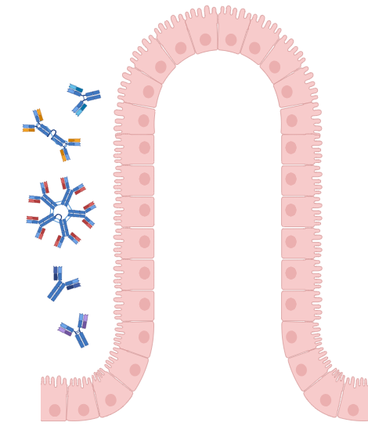
Traveling Antibodies Continued - But how do the antibodies pass from colostrum to the calf when they drink?
Image created with Biorender.com.
Notes:
Source: Stott et al.: only available as a PDF (G.H. Stott, D.B. Marx, B.E. Menefee, G.T. Nightengale . Colostral immunoglobulin transfer in calves I. Period of absorption. J. Dairy Sci., 62 (1979), pp. 1632-1638
https://doi.org/10.3168/jds.S0022-0302(79)83472-4)
This structure is called a villi and they are made up of gut cells, even enterocytes.

Slide 11
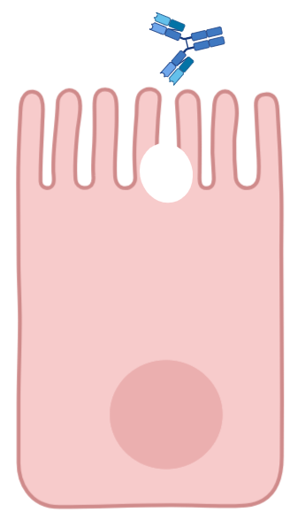
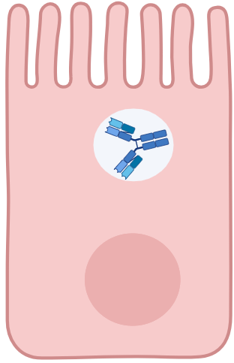
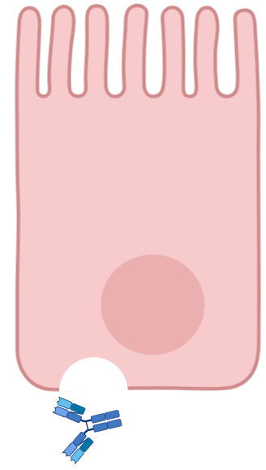
Traveling Antibodies Continued - But how do the antibodies pass from colostrum to the calf when they drink?
Bloodstream
Stott et al., 1979; Image created with Biorender.com.
Notes:
Source: Stott et al.: only available as a PDF (G.H. Stott, D.B. Marx, B.E. Menefee, G.T. Nightengale. Colostral immunoglobulin transfer in calves I. Period of absorption. J. Dairy Sci., 62 (1979), pp. 1632-1638
https://doi.org/10.3168/jds.S0022-0302(79)83472-4)
This is an overview of pinocytosis. The enterocyte cell will form the transport vesicle and engulf the antibody and what surrounds it to transport through the cell. Finally, the antibody is released on the other side of the cell to be transported to the blood stream.

Slide 12
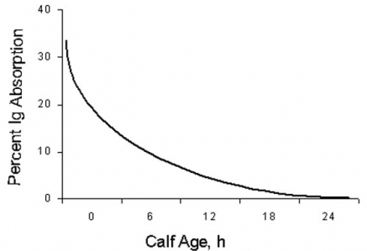
Gut Traffic - The gut “closes” transport around 24 hours of life. This is what we call gut closure.
40
We use the estimated timing of gut closure to determine when to feed colostrum.
Most recommendations say to feed colostrum within 4 hours of birth.
30
Percent Ig Absorption
20
10
0
0
6
12
18
24
Calf age, hour
Leece and Morgan, 1962; Stott et al., 1979
Notes:
Source: J.G. Lecce, D.O. Morgan. Effect of dietary regimen on cessation of intestinal absorption of large molecules (closure) in neonatal pigs and lambs. J. Nutr., 78 (1962), pp. 263-268. (https://doi.org/10.1093/jn/78.3.263).
Source: Stott et al.: (G.H. Stott, D.B. Marx, B.E. Menefee, G.T. Nightengale. Colostral immunoglobulin transfer in calves I. Period of absorption. J. Dairy Sci., 62 (1979), pp. 1632-1638
https://doi.org/10.3168/jds.S0022-0302(79)83472-4)
These studies helped demonstrate that gut closure does not allow for the transfer of antibodies through pinocytosis around 24 hour of life (1 day old). After this time, antibodies are transferred slower through receptor-mediated transport. This means a protein must bind the antibody to get it across the gut wall. This process often takes energy or certain conditions to make that transport happen – making it slower than “free” passage like pinocytosis. The gut already loses 50% of it’s pinocytosis transport capacity around hour 4-5 hours of life and only continues to decrease. To maximize the concentration of antibodies that get into the blood, feeding the calf in the right window of time is essential.

Slide 13
The 5 Q's - When we feed colostrum, we must follow the 5 Qs.
Quality: at least 50 g/L of IgG; gold standard is at least 22° Brix
Quantity: feed at 10-12% of birth weight
Quickness: feed within 4 hours (ideal)
Squeeky clean: aim for total plate counts <100,000 colony forming unis/mL to minimize contamination
Quantifying: At least 90% of calves should have successful transfer of passive immunity (serum Brix or total protein)
Godden & Lombard & Woolums, 2019
Notes:
Source: Godden & Lombard & Woolums: Godden S.M., Lombard J.E., Woolums A.R. Colostrum management for dairy calves. Vet. Clin. North Am. Food Anim. Pract. 2019;35:535–556. doi: 10.1016/j.cvfa.2019.07.005. 31590901.
While the calf needs to eat the first meal during the right window of time to maximize antibody delivery, there are 5 essential check-offs that must be met for it to be a “good meal”. A “good” colostrum meal for the calf must contain at least a certain concentration of IgG which is estimated to be around 22° Brix to make sure there is enough antibody supplied to the gut to transfer into the blood stream for optimal health. Because the calf tummy is smaller than an adult cow, each meal should be small enough that it does not overwhelm their stomach size. We already talked about the timing of feeding in the last slide, but to account for the chance of contamination or the presence of “bad things” to be in colostrum, the total plate count helps show the producer how many bacteria are present in the meal. Bacteria can be good and bad so keeping the count low helps lower the risk of the calf to eat bad bacteria before it has an immune response to help keep the balance. Finally, there are ways to quantity the successful transfer of passive immunity with a blood sample that will be talked about on the next slide.

Slide 14

Success! We can determine successful transfer of passive immunity with serum Brix or total protein.
Classification | Goal % of calves | Serum total protein, g/dL | Corresponding serum Brix °
Poor | < 10 | < 5.1 | < 8.1
Fair | 20 | 5.1 – 5.7 | 8.1 – 8.8
Good | 30 | 5.8 – 6.1 | 8.9 – 9.3
Excellent | > 40 | ≥ 6.2 | ≥ 9.4
Lombard et al., 2020; Image created with Biorender.com.
Notes:
Source: Lombard et al., 2020: Lombard, J. ∙ Urie, N. ∙ Garry, F. ...Consensus recommendations on calf-and herd-level passive immunity in dairy calves in the United States. J. Dairy Sci. 2020; 103:7611-7624. https://doi.org/10.3168/jds.2019-17955.
Remember how antibodies are transported to the bloodstream after crossing the gut wall? Well, we can collect a blood sample from calves that consumed colostrum and process it into serum. The serum is the watery portion of blood that contains proteins, like antibodies. Since calves need a little bit of time for their own immune systems to turn on, we have to set them up for success with transfer of passive immunity and ultimately, increase their odds of surviving, and not getting as sick. Did you know that there is still 5% of all calves born each year that die in the first few months of life and 30-40% get sick (this is old USDA survey data and another research study from Urie et al., 2018). Feeding them quality colostrum on time can help calves stay healthy!
Additional Source, not on slide: Urie et al., 2018: Urie, N.J. ∙ Lombard, J.E. ∙ Shivley, C.B. ... Preweaned heifer management on US dairy operations: Part V. Factors associated with morbidity and mortality in preweaned dairy heifer calves. J. Dairy Sci. 2018; 101:9229-9244. https://doi.org/10.3168/jds.2017-14019

Slide 15
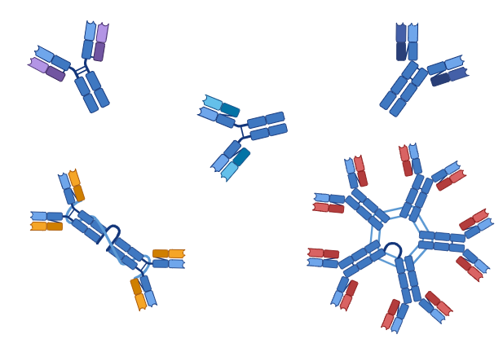
Now it is time for the activity!
Channel your inner antibody and get ready to MOO-ve!
Image created with Biorender.com.

Slide 16
Michigan State University Extension programs and materials are open to all without regard to race, color, national origin, sex, gender, gender identity, religion, age, height, weight, disability, political beliefs, sexual orientation, marital status, family status or veteran status.

